Slide 1

Machine learning in predicting sales of a new product
Zixing (Cecile) Wang

Slide 2
Machine Learning Steps
1. ETL pipeline
2. Identify promising machine learning models
3. Grid search for the best parameters
4. Predict sales on product of interest

Slide 3
Machine Learning Independent & Dependent Variables
Independent Variables
'Title’,
'Price’,
'FBA fee’,
'Rating’,
'Review Count’,
'Weight’,
'Images’,
'Review Ratio’,
'Size Tier Numeric’,
'Volume’,
'Size Tier’ -→ category to numeric
‘Fulfillment’, → category to numeric
'Listing Length'
Dependent Variable
Sales

Slide 4
Machine Learning Models Screening
Linear regression
Ordinary Least Squares
Elastic-Net
Polynomial regression
Does not work for the polynomial Features transform.
Random Forest
Decision Tree
Support Vector Regressor
Training set size:
1144 rows (entries)
1511 columns (features)

Slide 5
Machine Learning Models Screening – Linear Regression
 | Ordinary Least Squares | Elastic - Net
MAE | 4.61e+8 | 3443
MSE | 1.76e+18 | 5.46e+7
R2 | -0.021 | 0.23
alpha=1.0,
l1_ratio=0.5,
fit_intercept=True,
normalize=False,
precompute=False,
max_iter=1000,
copy_X=True,
tol=0.0001,
warm_start=False,
positive=False,
random_state=None,
selection='cyclic'
Linear regression isn’t a suitable for the data as we can see the R2 score is relatively low.

Slide 6
Machine Learning Models Screening – Trees & Support Vector
 | Random Forest | Decision Tree | Support Vector
MAE | 1524 | 1614 | 4370
MSE | 18815306 | 35107250 | 140002352
R2 | 0.76 | 0.64 | -14961289
n_estimators=100, criterion='mse', max_depth=None, min_samples_split=2, min_samples_leaf=1, min_weight_fraction_leaf=0.0, max_features='auto', max_leaf_nodes=None, min_impurity_decrease=0.0, min_impurity_split=None, bootstrap=True, oob_score=False, n_jobs=None, random_state=None, verbose=0, warm_start=False, ccp_alpha=0.0, max_samples=None
criterion='mse', splitter='best', max_depth=None, min_samples_split=2, min_samples_leaf=1, min_weight_fraction_leaf=0.0, max_features=None, random_state=None, max_leaf_nodes=None, min_impurity_decrease=0.0, min_impurity_split=None, presort='deprecated', ccp_alpha=0.0
Random forest and decision tree are the two promising models for machine learning.

Slide 7
Grid Search CV – Random Forest
Grid Search Parameters:
n_estimators":range(50, 300, 50)
"max_depth": range(5,20,5)
'ccp_alpha': (0, 0.005, 0.01, 0.015, 0.02)
 | Screening (Default) | Grid Search Results
MAE | 1524 | 1480
MSE | 18815306 | 17952473
R2 | 0.76 | 0.77
Screening parameters:
ccp_alpha = 0
max_depth=None
n_estimators=100
Grid search best estimator parameters:
ccp_alpha = 0.005
max_depth=15
n_estimators=50

Slide 8
Grid Search CV – Decision Tree
Grid Search Parameters:
'criterion':['mse', 'friedman_mse', 'mae’],
'min_samples_split': range(2, 10, 4),
'ccp_alpha': (0, 0.005, 0.01, 0.015, 0.02)
 | Screening (Default) | Grid Search Results
MAE | 1614 | 1572
MSE | 35107250 | 29327971
R2 | 0.64 | 0.79
Screening parameters:
criterion=‘mse’
min_samples_split=2
ccp_alpha=0.00
Grid search best estimator parameters:
criterion='mae’
min_samples_split=2
ccp_alpha=0.01

Slide 9
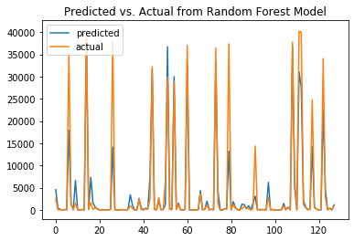
Best model
Random Forest:
ccp_alpha = 0.005
max_depth=15
n_estimators=50
MAE: 1480
MSE: 17952473
R2: 0.77
In general, the prediction is in sync with the actual number. However, the prediction tends to be higher for lower sales, and lower for higher sales.

Slide 10
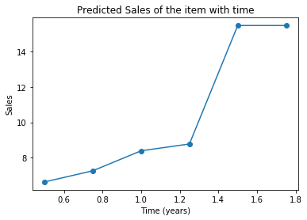
Predict Sales on product of interest
 | Actual data | Random Forest (default) | Random Forest (Grid search) | Decision Tree (default) | Decision Tree (Grid search)
Estimated Sales | 9 | 13 | 8.5 | 14 | 15
Difference |  | 44% | 5.6% | 56% | 67%
The best random forest model gives the best estimation with only 5.6% error. It predicts a slow growth of the product in the first 1.2 years, but an increase to 16 sales afterwards.

Slide 11
Conclusion
There is a trend between the different product features and the sales.
The best model has MAE of 1480, MSE of 29327971.91015625, R2 score of 0.79
The errors are still decently high from the MAE number.
The predicted sales tends to be higher for lower sales, and lower for actual high sales.
For our product of interest, the prediction only yields 5% error.
A time-dependent prediction shows that the sales will go up by 2 folds after one year.
Applications:
This estimator can be used to find the best features (title, image number, etc) to maximize sales.
The forecasting of sales can also be helpful for inventory planning.

Slide 12
Code source
GitHub: https://github.com/cec-wang/Amazon-sells-processing/blob/master/Amazon%20Machine%20Learning%20Pipeline.ipynb

